Slide 1
A First Book of ANSI C Fourth Edition
Chapter 9
Character Strings

Slide 2
Objectives
String Fundamentals
Library Functions
Input Data Validation
Formatting Strings (Optional)
Case Study: Character and Word Counting
Common Programming and Compiler Errors

Slide 3
String Fundamentals
A string literal is any sequence of characters enclosed in double quotes
"Good Morning!"
Also called: string constant, string value, string
A string is stored as an array of characters terminated by an end-of-string symbolic constant named NULL ('\0')

Slide 4
String Input and Output
gets() accepts and stores the characters typed at the terminal into the character array
Pressing the Enter key generates a newline character, \n, which is interpreted by gets() as the end-of-character entry
All the characters encountered by gets(), except the newline character, are stored in the message array

Slide 5
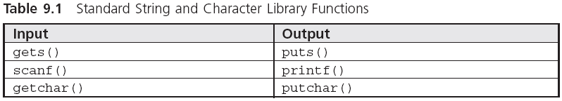
String Input and Output (continued)

Slide 6
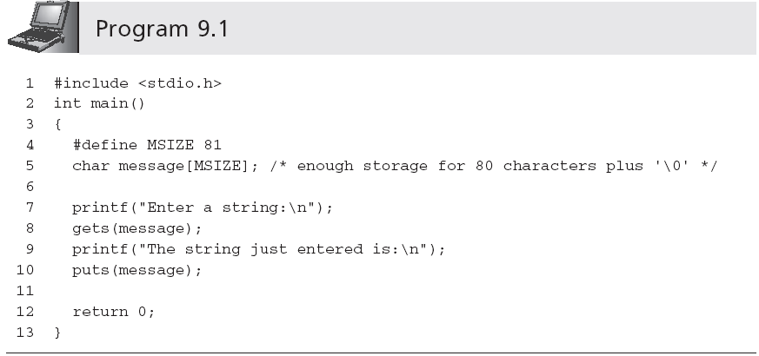
String Input and Output (continued)
Sample run:
Enter a string:
This is a test input of a string of characters.
The string just entered is:
This is a test input of a string of characters.

Slide 7
String Input and Output (continued)
A printf() function call can be used in place of a puts() function call
printf("%s\n",message); ≡ puts(message);
This correspondence between the output functions is not duplicated by the input functions scanf() and gets()
scanf() reads a set of characters up to either a blank space or a newline character
scanf("%s",message); //No & is required
gets() stops accepting characters only when a newline is detected

Slide 8
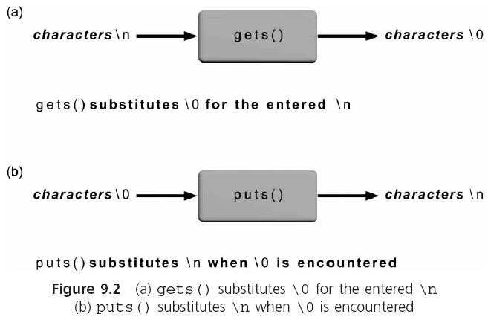
String Input and Output (continued)

Slide 9
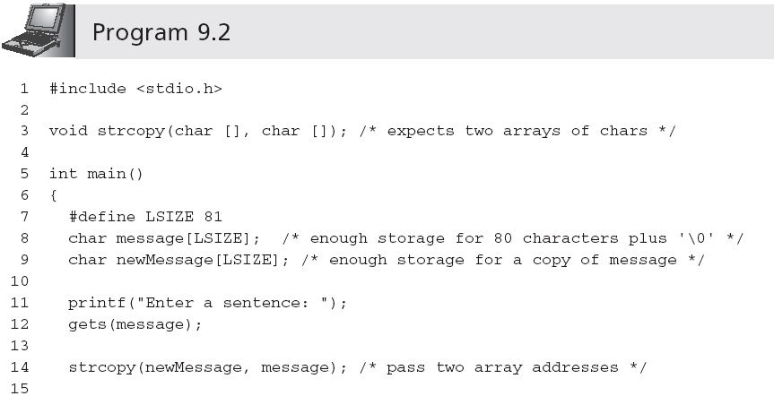
String Processing

Slide 10
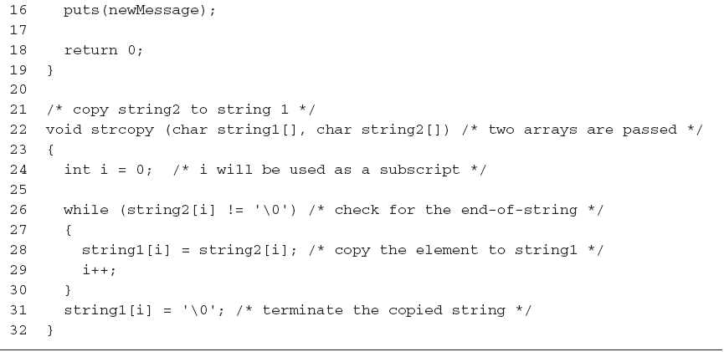
String Processing (continued)

Slide 11
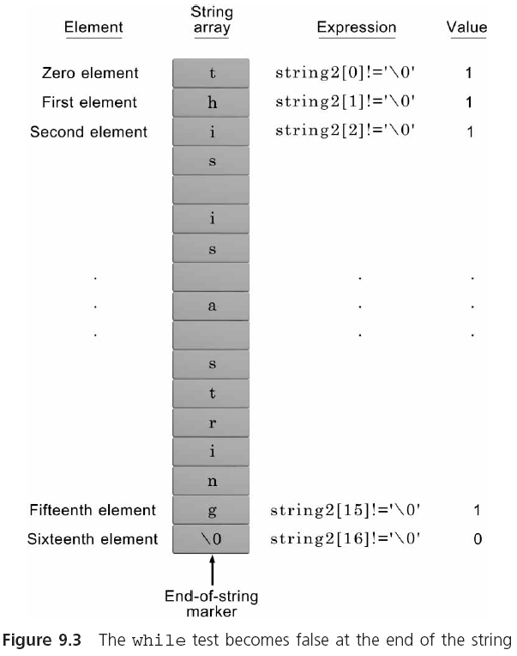
String Processing (continued)
NOTE: Because the expression string2[i] is only 0 at the end of a string and non-0 for every
other character, the expression while (string2[i] != '\0') can be replaced by the
simpler expression while (string2[i]).

Slide 12
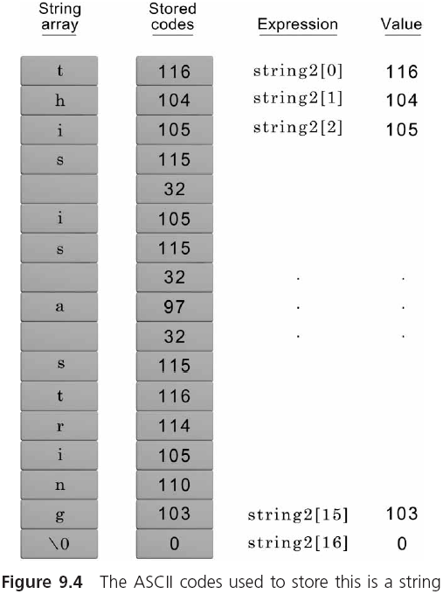
String Processing (continued)

Slide 13
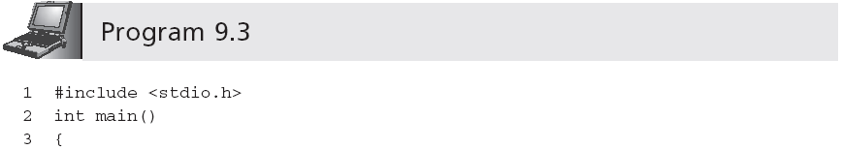
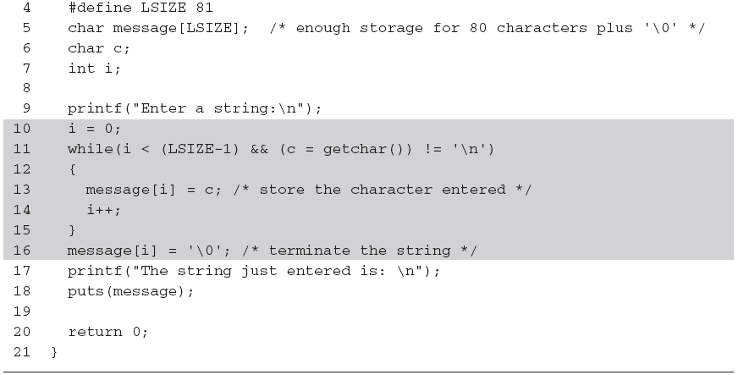
String Processing (continued)
Be careful: omitting the parentheses causes the entire expression to be equivalent to
c = (getchar() != '\n')

Slide 14
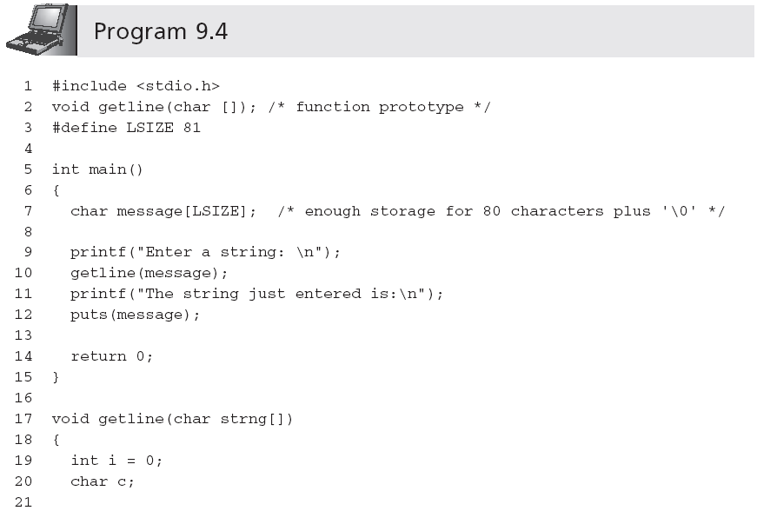
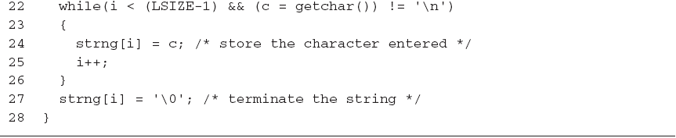
String Processing (continued)

Slide 15
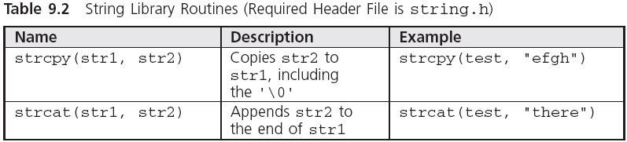
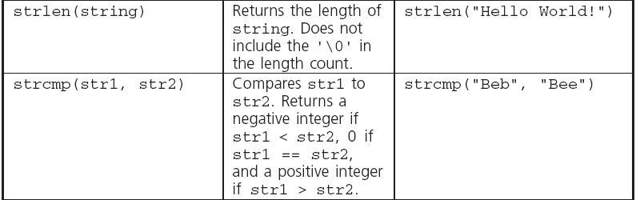
Library Functions
Note: Attempting to copy a larger string into a smaller string causes the copy to overflow the destination array beginning with the memory area immediately following the last array element.

Slide 16
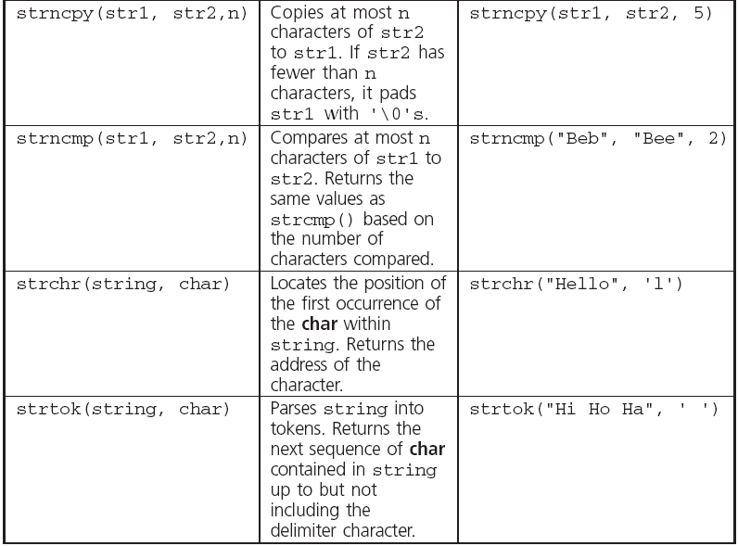
Library Functions (continued)

Slide 17
Library Functions (continued)
When comparing strings, their individual characters are evaluated in pairs; if a difference is found, the string with the first lower character is the smaller one
"Good Bye" is less than "Hello" because the first 'G' in Good Bye is less than the first 'H' in Hello
"Hello" is less than "Hello " because the '\0' terminating the first string is less than the ' ' in the second string
"123" is greater than "122" because '3' in 123 is greater than '2' in 122
"1237" is greater than "123" because '7' in 1237 is greater than '\0' in 123

Slide 18
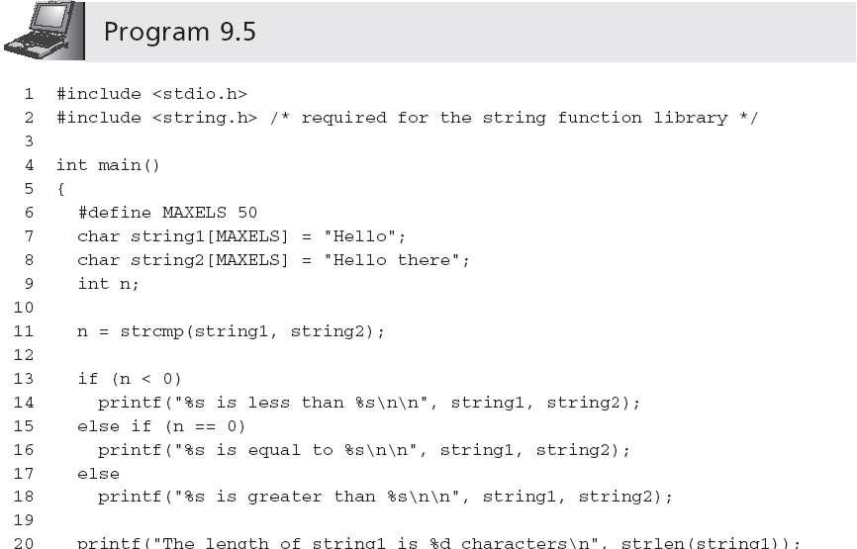
Library Functions (continued)

Slide 19
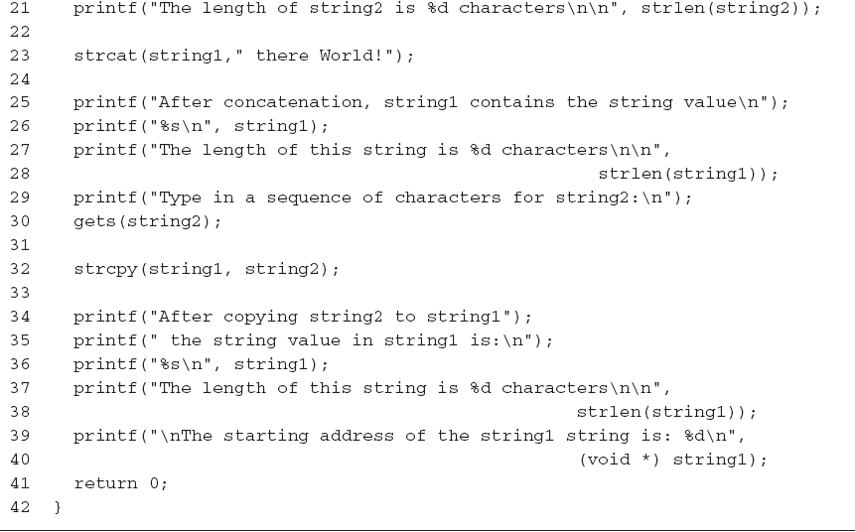
Library Functions (continued)

Slide 20
Library Functions (continued)
Sample output:
Hello is less than Hello there
The length of string1 is 5 characters
The length of string2 is 11 characters
After concatenation, string1 contains the string value
Hello there World!
The length of this string is 18 characters
Type in a sequence of characters for string2:
It's a wonderful day
After copying string2 to string1, the string value in string1 is:
It's a wonderful day
The length of this string is 20 characters
The starting address of the string1 string is: 1244836

Slide 21
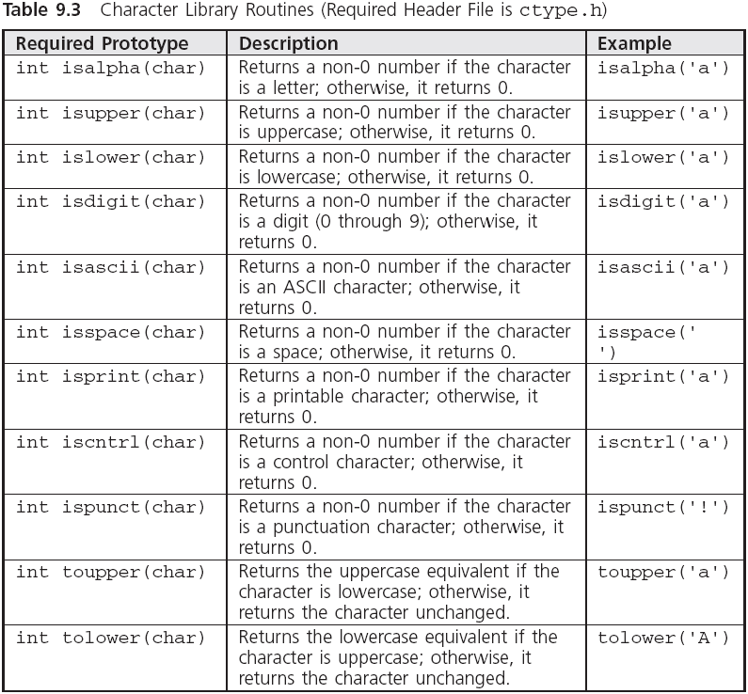
Character Routines

Slide 22
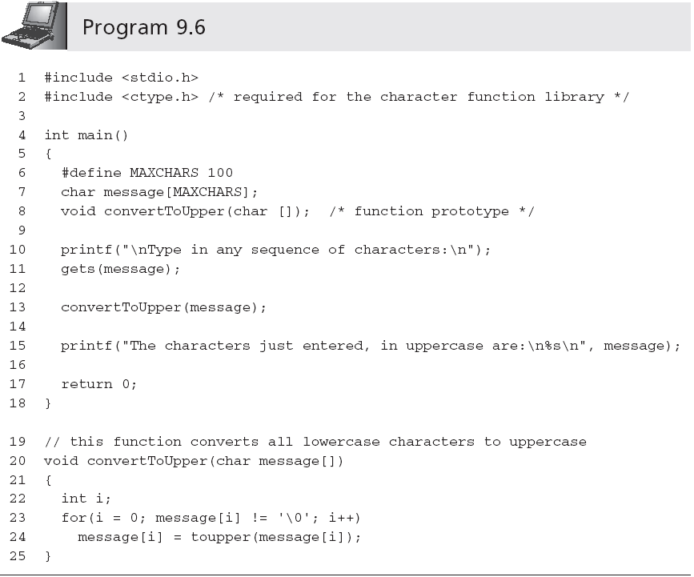
Character Routines (continued)

Slide 23
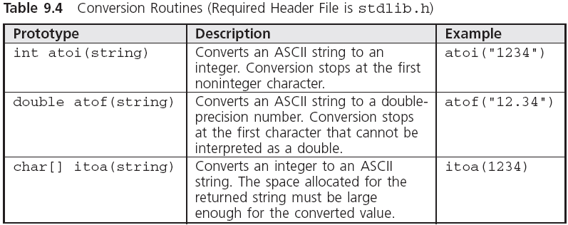
Conversion Routines

Slide 24
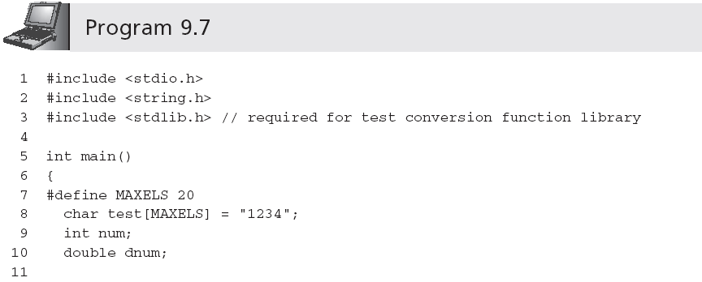
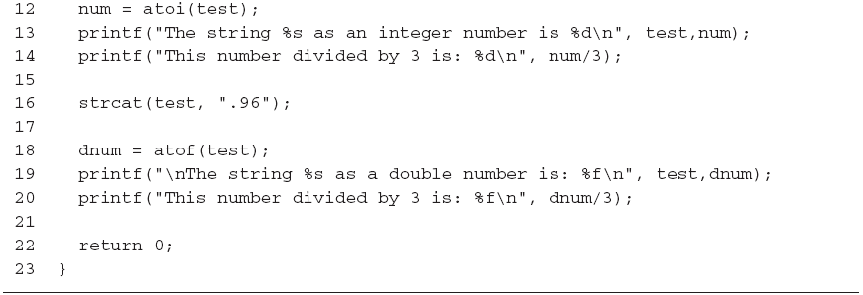
Conversion Routines (continued)

Slide 25
Input Data Validation
Successful programs always try to anticipate invalid data and isolate such data from being accepted and processed
First validate that the data is of the correct type; if not, request the user to re-enter the data
Explain why the entered data was invalid
One of the most common methods of validating input data is to accept all numbers as strings
Each character can then be checked to ensure that it complies with the data type being requested

Slide 26
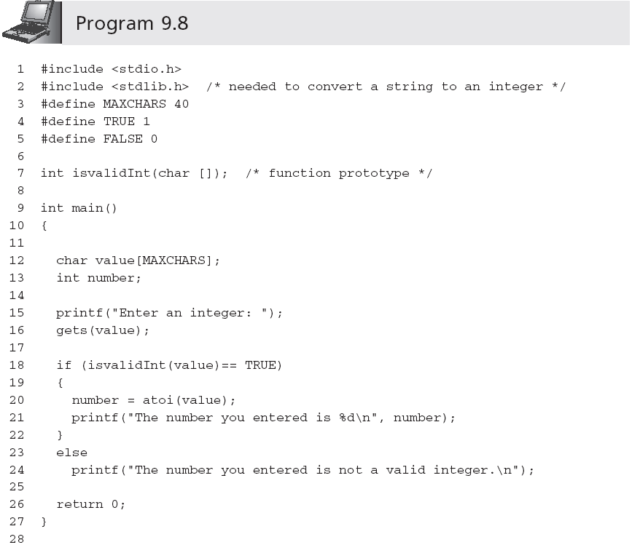
Input Data Validation (continued)

Slide 27
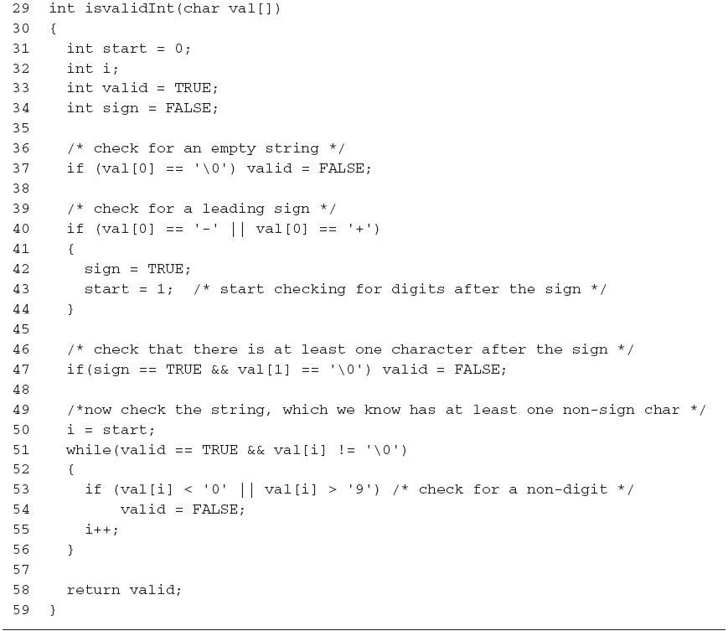
Input Data Validation (continued)

Slide 28
Input Data Validation (continued)
We can use isvalidInt() in a loop that continually requests an integer until a valid integer value is entered
Set an integer variable named isanInt to 0
do
Accept a string value
If the string value does not correspond to an integer
Display the error message "Invalid integer - Please re-enter: "
Send control back to expression being tested by the do-while statement
Set isanInt to 1 (this causes the loop to terminate)
while(isanInt is 0)
Return the integer corresponding to the entered string

Slide 29

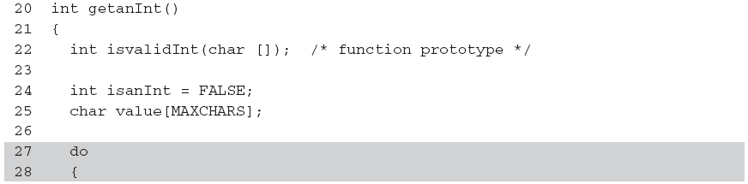
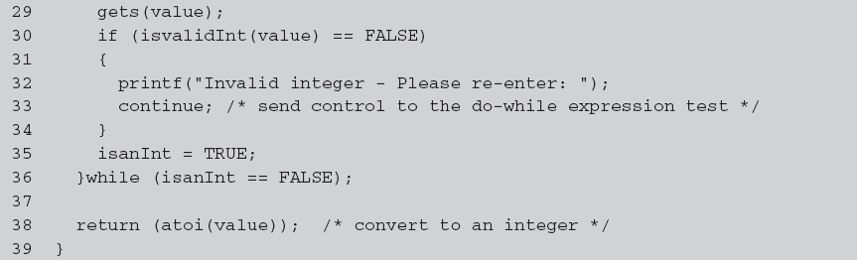
Input Data Validation (continued)
…

Slide 30
Creating a Personal Library
Programmers create their own libraries of functions
This permits the functions to be incorporated in any program without further expenditure of coding time
Each file in a library contains related functions
#include <C:\\mylibrary\\dataChecks.h>
#include "C:\\mylibrary\\dataChecks.h"
The #include statement for dataChecks.h must be placed after the #include statements for the stdio.h and stdlib.h header files (the functions in dataChecks.h require stdio.h and stdlib.h functions to correctly compile)

Slide 31
Formatting Strings
Examples:
printf("|%25s|","Have a Happy Day");
| Have a Happy Day|
printf("|%-25s|","Have a Happy Day");
|Have a Happy Day |
printf("|%25.12s|","Have a Happy Day");
| Have a Happy|
printf("|%.12s|","Have a Happy Day");
|Have a Happy|

Slide 32
In-Memory String Conversions
The sprintf() and sscanf() functions provide capabilities for writing and scanning strings to and from memory variables
sprintf(disStrn,"%d %d", num1, num2);
sscanf(data,"%c%lf %d",&dol,&price,&units);
"$23.45 10"
sscanf(date,"%d/%d/%d", &month, &day, &year);
"07/01/94"

Slide 33
Format Strings
The control string containing the conversion control sequences need not be explicitly contained within the function
printf("$%5.2f %d",num1,num2);
Or,
char fmat[] = "$%5.2f %d";
printf(fmat,num1,num2);
Useful for listing format strings with other variable declarations at the beginning of a function
If you need to change a format, it is easy to find the desired control string without searching to locate the appropriate printf() or scanf() function calls

Slide 34
Case Study: Character and Word Counting
We construct two string-processing functions
Count the number of characters in a string
Count words in a sting
What constitutes a word?

Slide 35
Program Requirement: Character Counting
Pass a string to a function and have the function return the number of characters in the string
Any character in the string (blank, printable, or nonprintable character) is to be counted
The end-of-string NULL character is not to be included in the final count

Slide 36
Analyze the Problem
Determine the input data
Determine the required outputs
List the algorithm(s) relating the inputs to the outputs

Slide 37
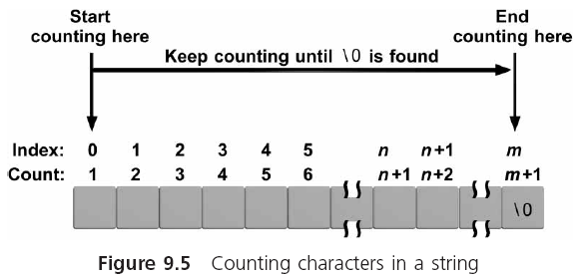
Analyze the Problem (continued)

Slide 38
Code the Function
int countchar(char list[])
{
int i, count = 0;
for(i = 0; list[i] != '\0'; i++)
count++;
return(count);
}

Slide 39
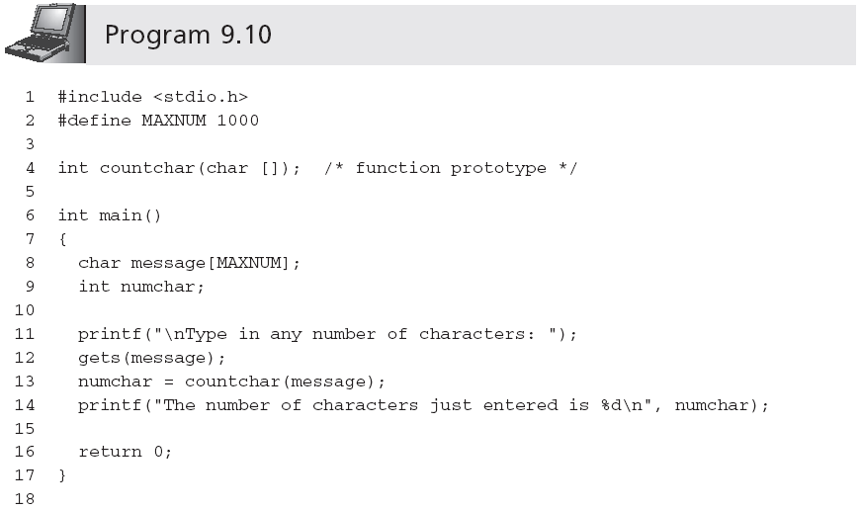
Test and Debug the Function
…

Slide 40
Requirement Specification: Word Counting
The last word does not have a trailing blank
More than one blank may be used between words
Leading blanks may be used before the first word

Slide 41
Analyze the Problem
Determine the input data
Determine the required outputs
Algorithm:
Set an integer variable named inaword to the symbolic constant NO
Set the word count to 0
For all the characters in the array
If the current character is a blank
set inaword to NO
Else if (inaword equals NO)
set inaword to the symbolic constant YES
increment the word count
EndIf
EndFor
Return the count

Slide 42
Code the Function
int countword(char list[])
#define YES 1
#define NO 0
{
int i, inaword, count = 0;
inaword = NO;
for(i = 0; list[i] != '\0'; i++)
{
if (list[i] == ' ')
inaword = NO;
else if (inaword == NO)
{
inaword = YES;
count++;
}
}
return(count);
}

Slide 43
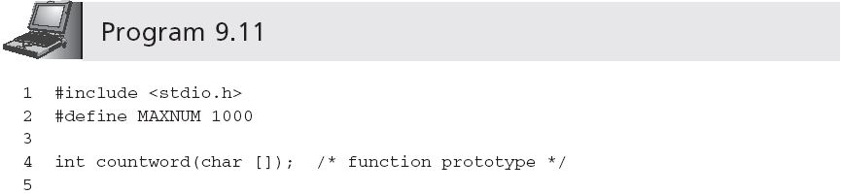
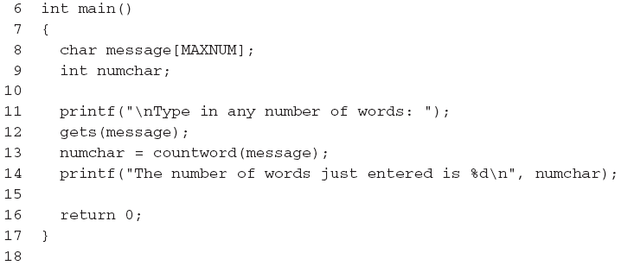
Test and Debug the Function
…

Slide 44
Test and Debug the Function (continued)
A sample run using Program 9.11 follows:
Type in any number of words: This is a test line with a bunch of words
The number of words just entered is 10
Further tests that should be performed are
Enter words with multiple spaces between them
Enter words with leading spaces before the first word
Enter words with trailing spaces after the last word
Enter a sentence that ends in a period or question mark

Slide 45
Common Programming Errors
Forgetting the terminating NULL character, '\0', when processing existing strings in a character-by-character manner
Forgetting to terminate a newly created character string with the NULL character
Forgetting that the newline character, '\n', is a valid data input character
Forgetting to include the string.h, ctype.h, and stdlib.h header files when using the string library, character library, and conversion library functions, respectively

Slide 46
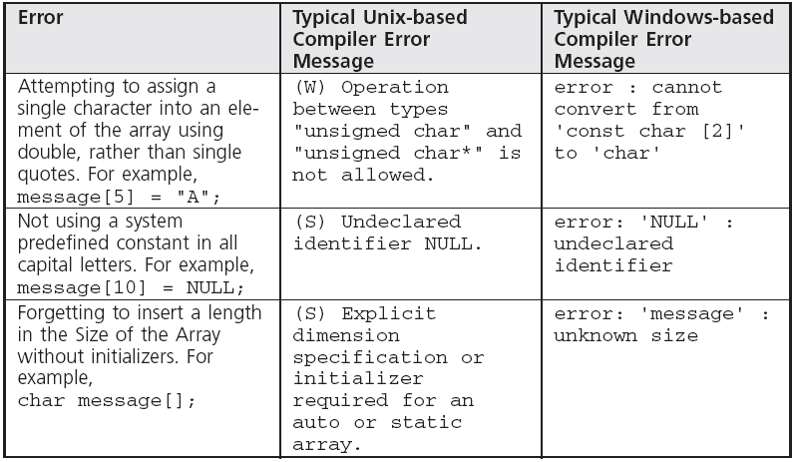
Common Compiler Errors

Slide 47
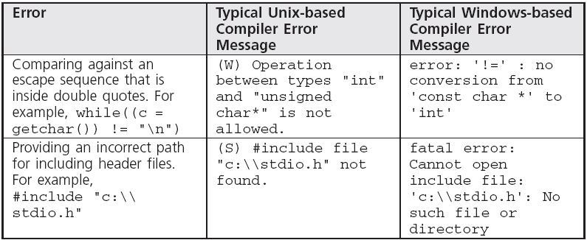
Common Compiler Errors (continued)

Slide 48
Summary
A string is an array of characters terminated by the NULL ('\0') character
Character arrays can be initialized using a string assignment of the form char arrayName[] = "text";
Strings can always be processed using standard array-processing techniques
The gets(), scanf(), and getchar() library functions can be used to input a string
The puts(), printf(), and putchar() functions can be used to display strings

Slide 49
Summary (continued)
Many standard library functions exist for processing strings as a complete unit
The standard C library also includes individual character-handling functions (ctype.h)
One of the major uses of strings is validating user input, which is an essential part of any program
The conversion routines atoi() and atof() are provided in the stdlib.h header file for converting strings to integer and double-precision numeric values

